Slide 1



Introduction to
Vision Based Adaptive Cruise Control

Slide 2

Learning Objective
Introduction to Adaptive Cruise Control (ACC) System
Advantages of ACC
Limitations of ACC
Practical Example of ACC
Vision Based ACC
Role of Vision Based ACC in Self Driving Cars

Slide 3
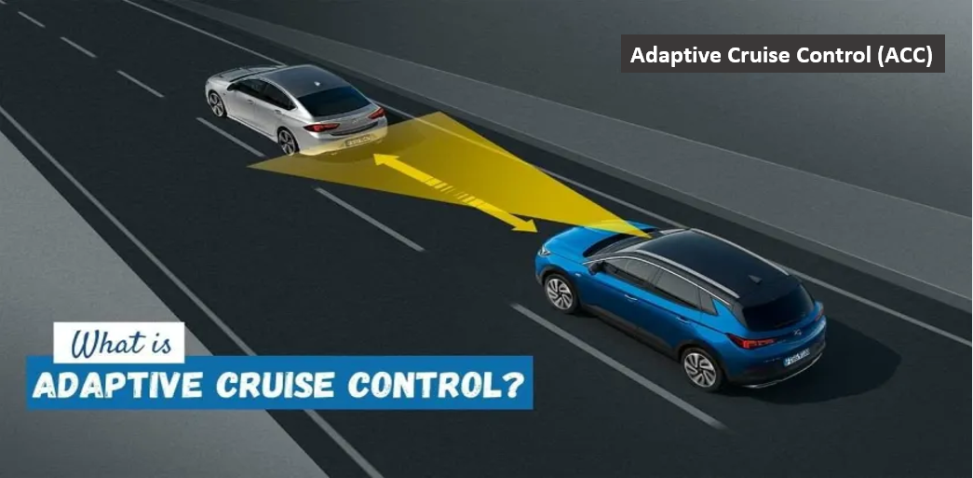
Introduction

Slide 4
Adaptive Cruise Control
An Adaptive Cruise Control (ACC) is autonomous.
It uses the onboard sensors such as radar to maintain the desired spacing.
ACC is a system designed to help vehicles maintain a safe following distance and stay within the speed limit.
This system adjusts a car’s speed automatically so drivers don’t have to do.

Slide 5
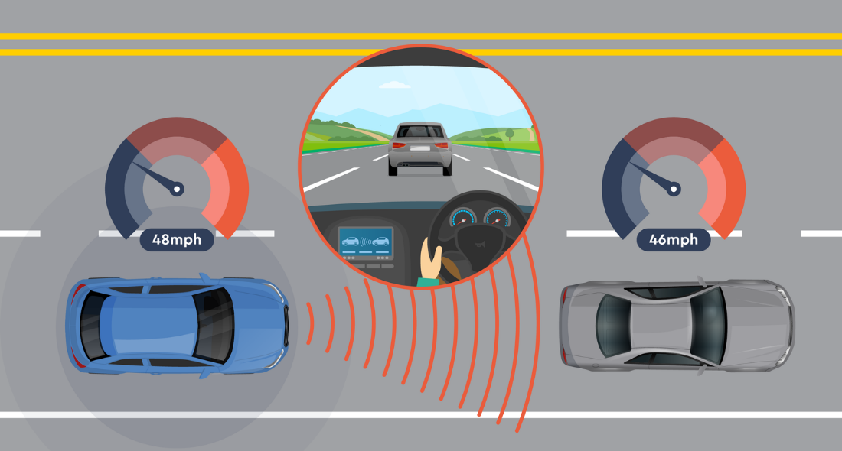
Adaptive Cruise Control

Slide 6
Adaptive Cruise Control
Cruise Control is one of the valuable feature in modern cars.
The cruise control system is to accurately maintain a speed set by the driver without any outside intervention by controlling the throttle accelerator pedal linkage.
Without ACC, long road trips would be far more tiring, at least for the driver.

Slide 7
Adaptive Cruise Control
ACC has multiple names or terms (almost 20 terms) that can be used officially anywhere.
Active Cruise Control
Radar Cruise Control
Autonomous Cruise Control
Intelligent Cruise Control
Dynamic Cruise Control
ETC

Slide 8
Advantages of ACC
ACC technologies allow the car to detect and warn the driver about potential forward collision.
The warning can be in “Red Light” or the “Audible.”
Increase road safety
Prevent accidents
Maximize the traffic flow
Automatically control speed
Driver friendly

Slide 9
Limitations of ACC
Along with advantages there are still some limitations for ACC.
For that purposes driver needs to practice the safe driving habits.
It is not fully autonomous so driver need to be fully practiced and expert.
Weather conditions like snow, rain, or fog might confuse the system’s onboard sensors as well as environmental factors such as driving through tunnels.

Slide 10
Practical Example of ACC

Slide 11
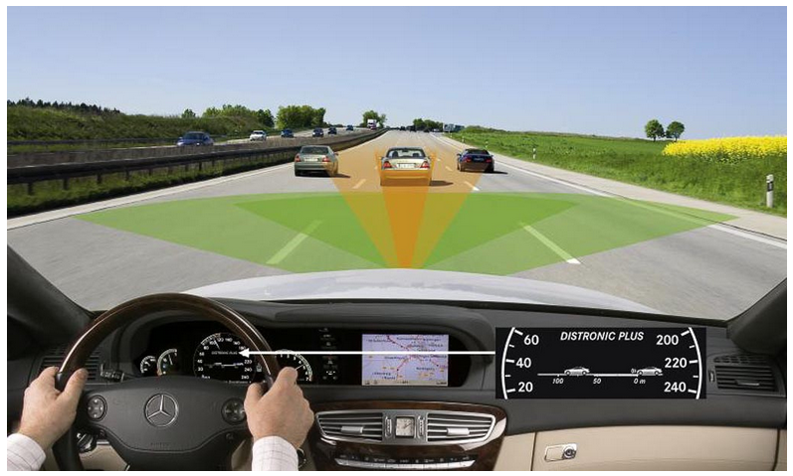
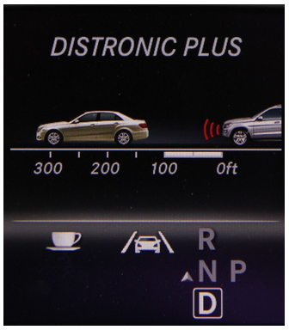
Practical Example of ACC

Slide 12
Vision Based ACC
Using any vision system with Adaptive Cruise Control (ACC) makes the system Vision-Based Adaptive Cruise Control.
For this purpose a monocular vision system provides the distance between the ego vehicle and the preceding vehicle on the road.
Such complete system is called and understood as a Vision-Based ACC.

Slide 13
Vision Based ACC
Uses Fuzzy Logic that assists the velocity vehicle control offering driving strategies and actuation over the throttle of car.
In this type of controller the automated sensing devices are embedded in an automatic driving system to make it more intelligent.
Sensing Camera, Sonar, Radar, LADAR, Monocular Color Vision, and other sensors are used for this Vision Based ACC.

Slide 14
Vision Based Vehicle Detection
Obstacles detection is very basic skill in every autonomous vehicle for reliable navigation.
A monocular color vision system is deployed in this work in order to provide the vehicle with visual reactive capacity.
Vision Based ACC is expected to provide more accurate range.

Slide 15
Vision Based ACC
Find target vehicle.
Determine where the target vehicle is along the driving path.
Measure distance to the target vehicle.
Perform the necessary throttle or braking actuation to maintain a safe distance from the target vehicle.
If no target vehicle is present then the ACC vehicle should resume a present cruising speed.

Slide 16
VB-ACC Pattern Matching Example
It works by searching an image for predefined template.
Normalized cross-correlation is the most common way to find the template in image and is used for vehicle detection.
For an ACC system, implementing vehicle pattern matching directly may not be a practical solution because it would require massive database templates of various vehicle types.

Slide 17
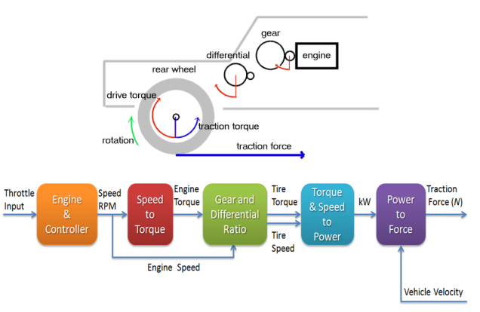
VB-ACC Pattern Matching Example

Slide 18
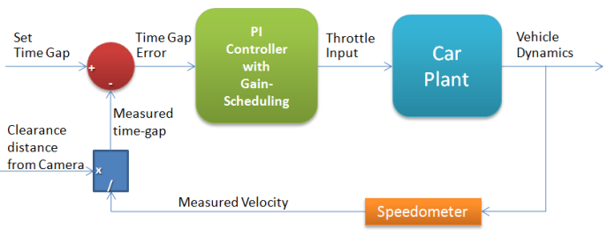
VB-ACC Pattern Matching Example

Slide 19
Role of VB-ACC
Very important role regarding the safety measures and other autonomous parameters.
Can avoid lots of road accidents.
Provide a RED light alert or AUDIBLE announcement when there is a chance for accident.
Very efficient and useable control.
Works with all type of sensors such as LADAR, Sonar, Radar and others.

Slide 20
Summary
Introduction to Adaptive Cruise Control (ACC) System
Advantages of ACC
Limitations of ACC
Practical Example of ACC
Vision Based ACC
Role of Vision Based ACC in Self Driving Cars

Slide 21
Thank You

